Slide 1
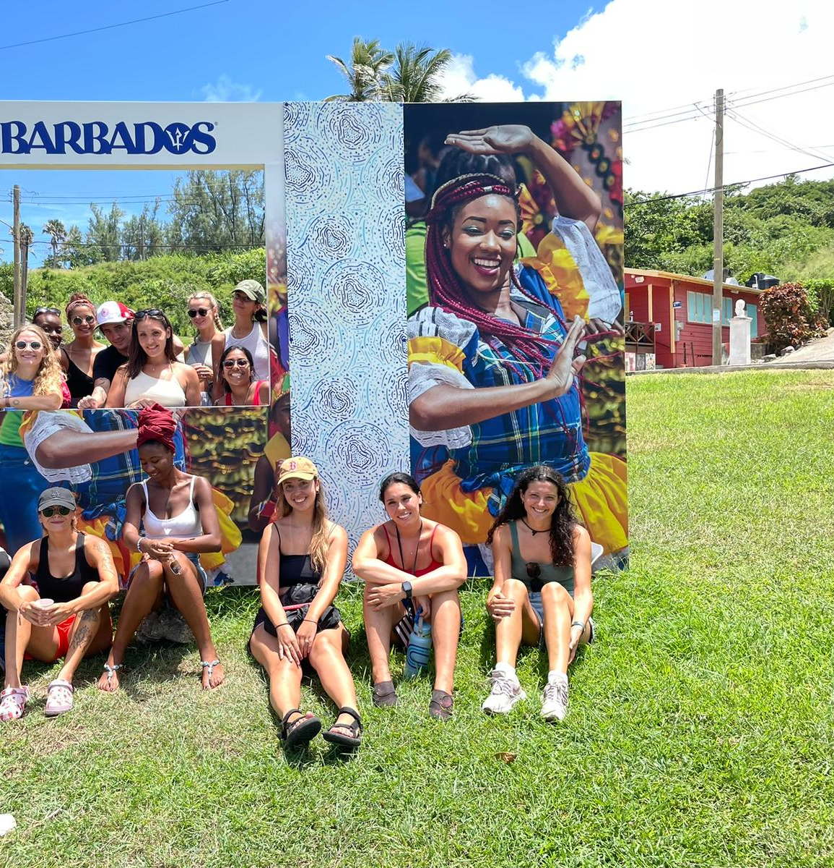

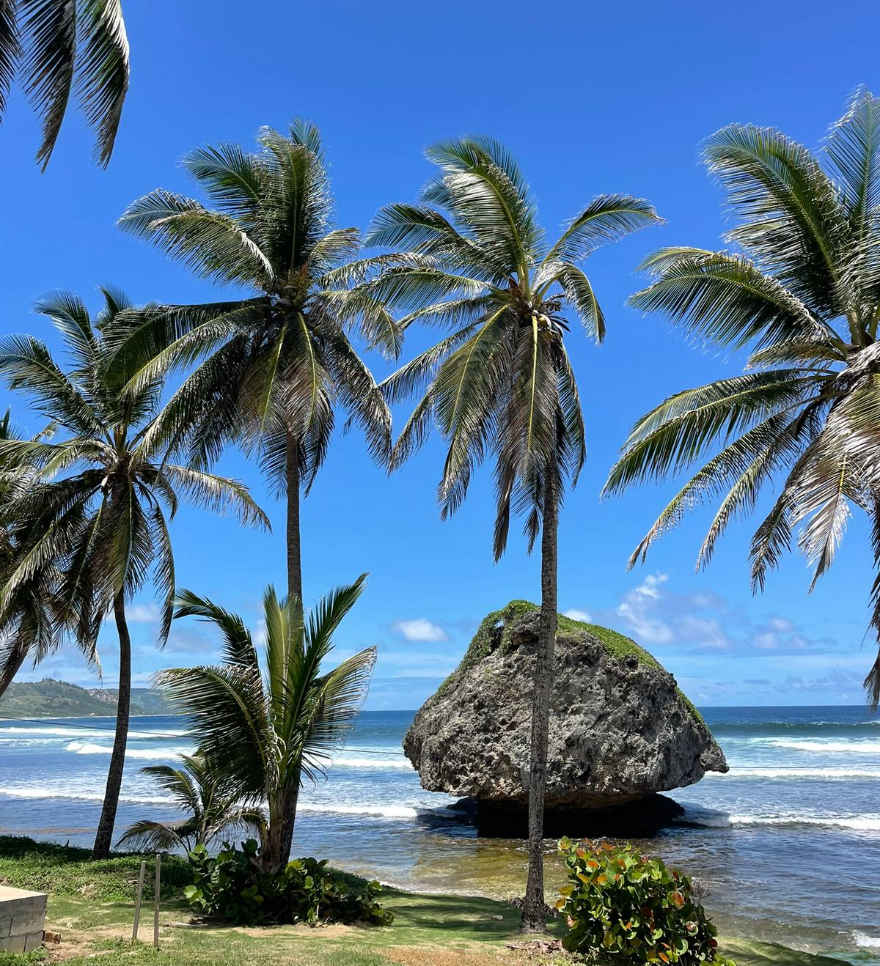

Who am I?
Rozalina Hermés
Undergraduate student at Malmö University in Sweden
Exchange semester at University of the West Indies in Barbados
MFS scholarship: Research in Brazil for bachelors´ thesis

Slide 2
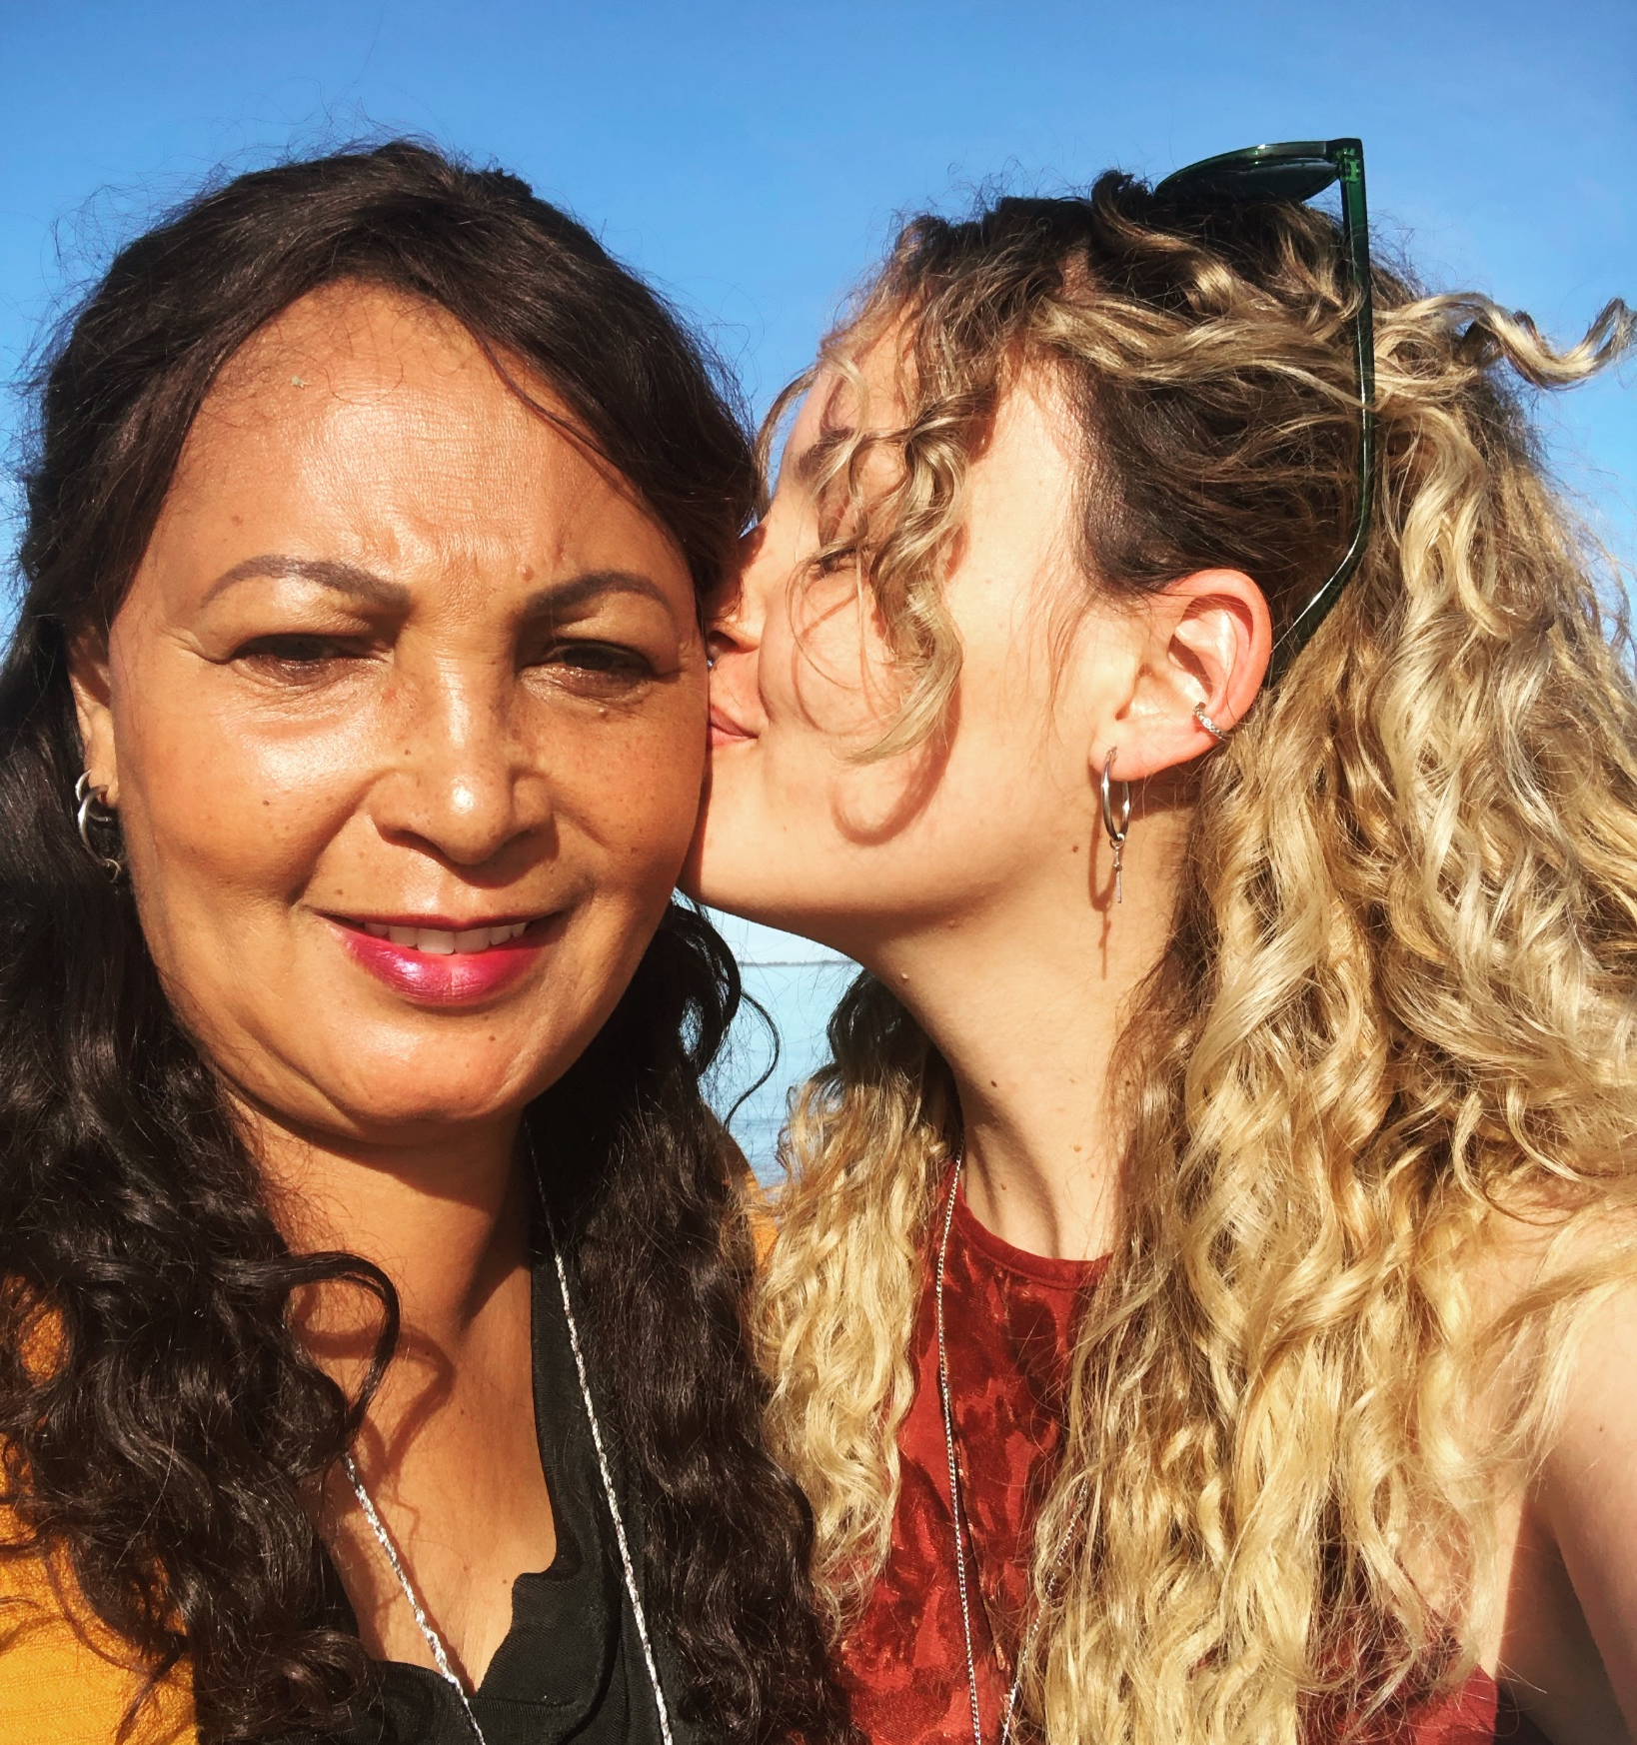
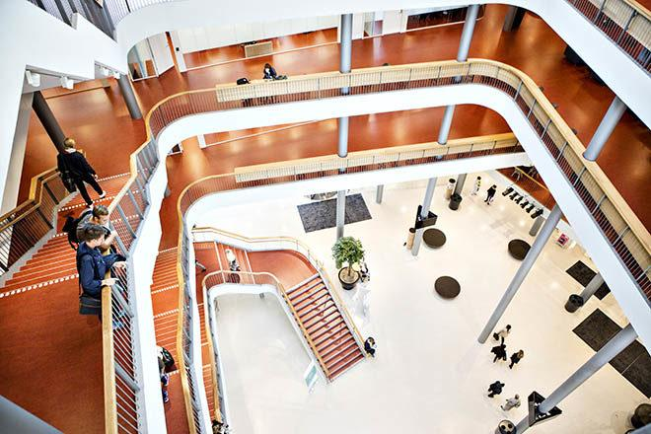

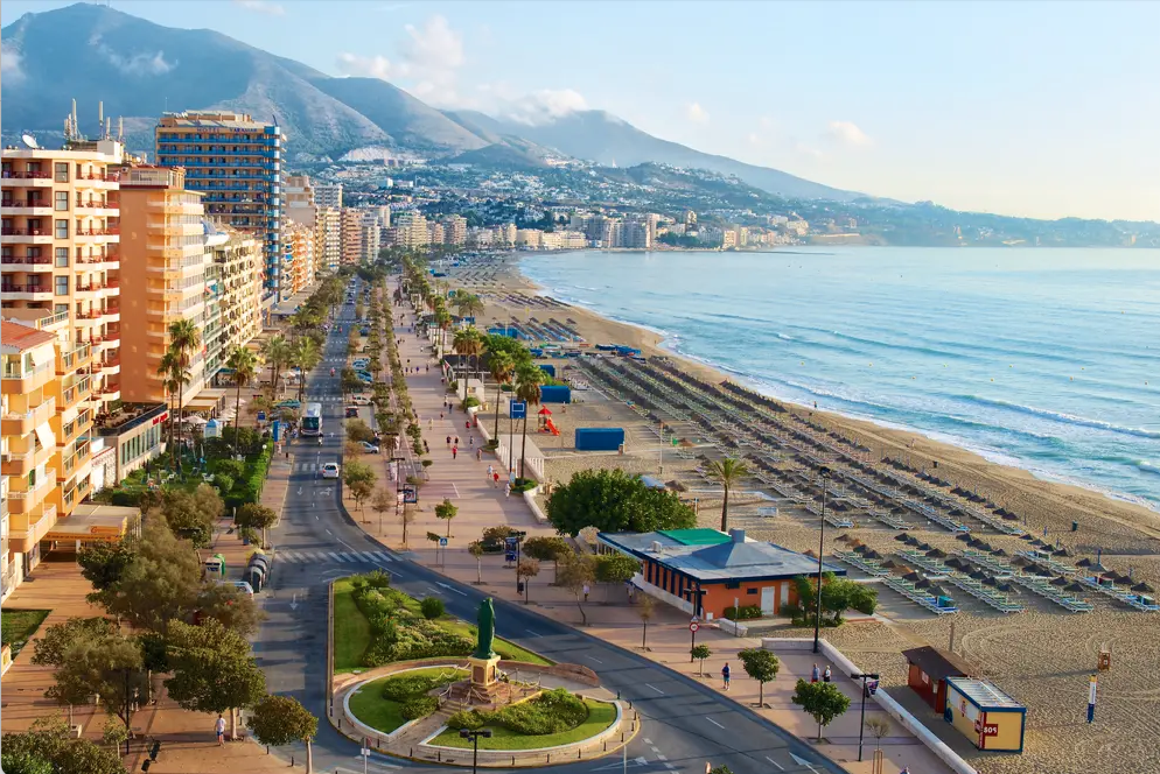
Who am I?
Nicole Lundgårdh
Undergraduate student at Malmö University in Sweden
International life experience: Sweden, England, Spain and Brazil
MFS scholarship: Research in Brazil for bachelors´ thesis

Slide 3
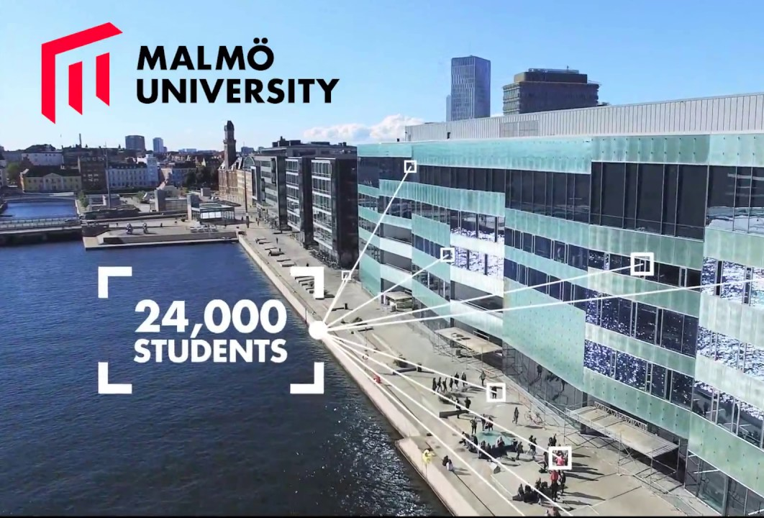

MFS Minor field studies

Slide 4

What is the study about?
Race relations / diversity in Brazil
Disparity in society
Different treatment among individuals
Experiences of university students
Quota & affirmative action

Slide 5

Why is this important?
Curious & want to learn more
Important to address
”Broadcast” the issue in Sweden to raise awareness
Interested in particular experiences of the participants

Slide 6

What does participation entail?
Interview for approx. 1 hour in English/Portuguese
Personal experiences
Info letter and consent form

Slide 7
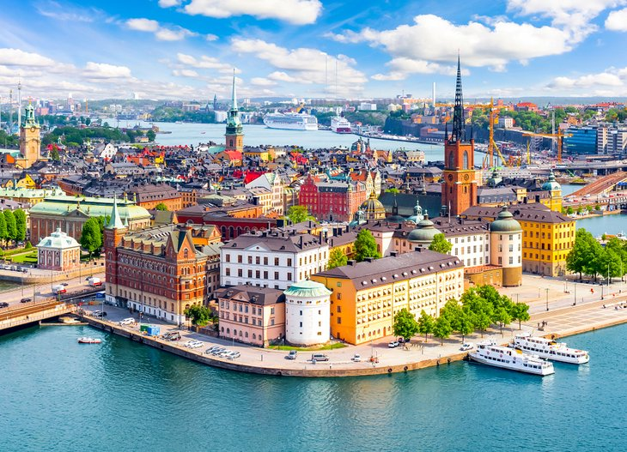
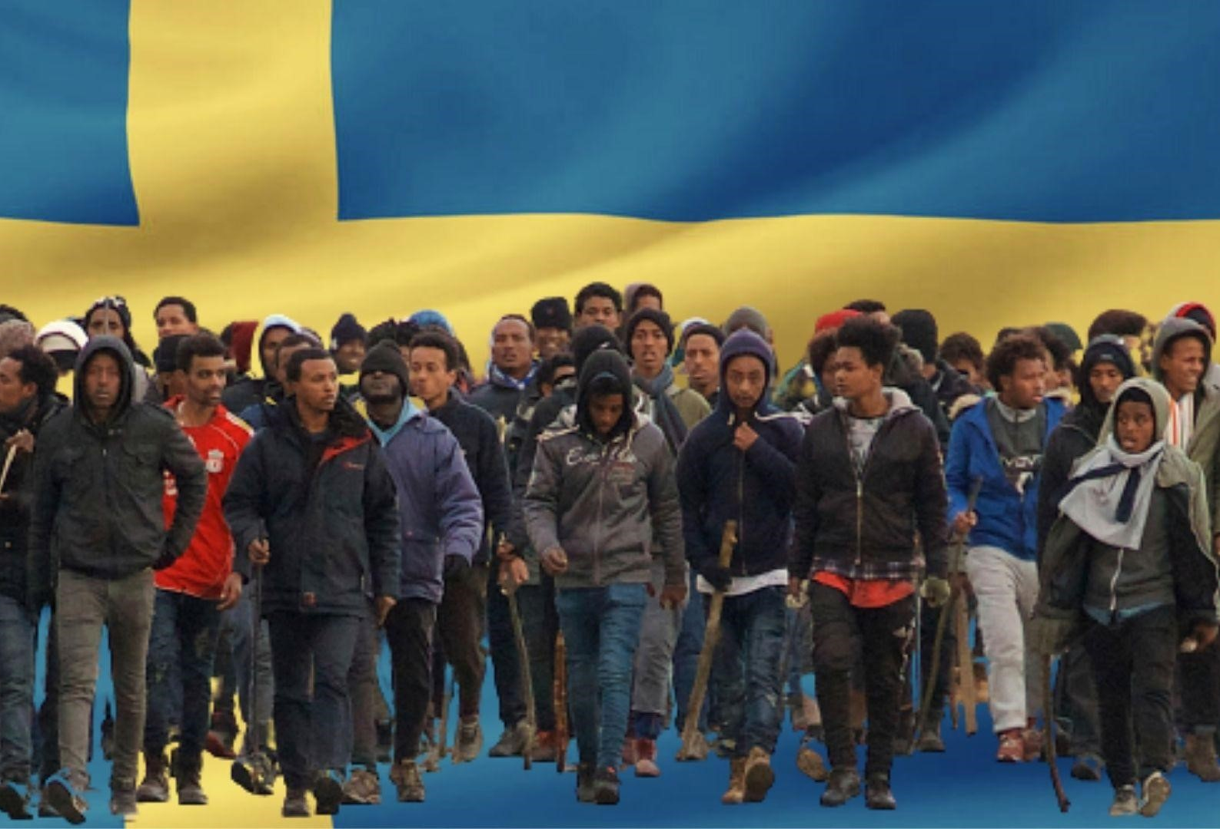
Diversity in Sweden
Mainly ethnic Swedes, Finns, Danes and Sami people (indigenous of northern part of Scandinavia)
Large waves of migration
Yugoslavia, Iraq, Syria, Iran, Ethiopia, Somalia and Lebanon
Multicultural society with 20% foreign born
Racism, exclusion and marginalization
Right wing SD

Slide 8


